Slide 1
Lecture 5

Slide 2
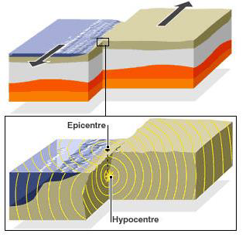
An earthquake is the shaking of the Earth's surface that is generated by the sudden release of energy
Deformations collected in the Earth's outer crust (Crust) or in
The layer below where these vibrations spread and reach the surface
The earth is a generator of the movement of the earth's surface, which is the source of damage

Slide 3
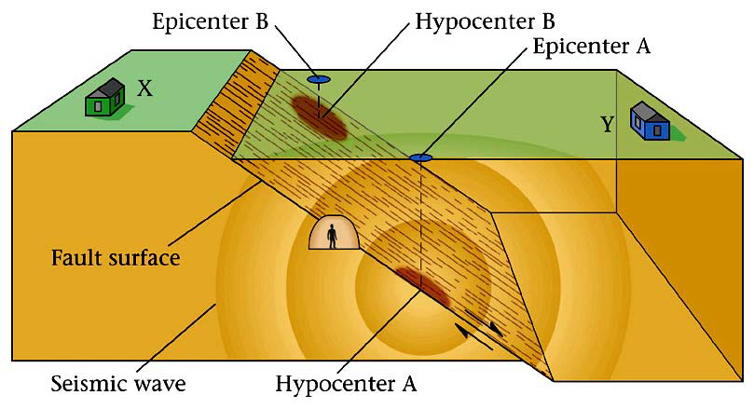
Epicenter and Focus
Hypocenter (Focus):actual location of the earthquake at depth
•Epicenter:location on the surface of the Earth above the hypocenter
•Hanging Wall:top block of a fault (where a light would hang from)
•Footwall:bottom block of a fault (where you would stand

Slide 4
Earthquake Cluster and Swarm
Foreshocks
Mainshock
Aftershocks
Earthquake Swarm
Earthquake swarms are events where a local area experiences sequences of many earthquakes striking in a relatively short period of time.
There are two types of seismic clusters: The clusters of foreshocks and aftershocks that occur before and after a big earthquake (mainshock).

Slide 7
1-Shallow earthquakes: the focal depth is 0- 70 km and constitutes 75 of the total earthquakes.
2-Medium earthquakes: the focus depth is 70 -300 km and they constitute 22 of the total earthquakes.
3-Deep earthquakes: focus depth is 300- 700 km and constitute 3 of the total earthquakes

